Slide 1
Lariat Recommendations
Presented by Jeffrey Zhu

Slide 2
Current situation
KPI | Results
Number of Cars | 4,000
Number of Locations | 50
Gross Revenue | $64,866,040
Number of Transactions | 100,000
Average Revenue/Transaction | $649
Revenue/Car | $16,217
Revenue/Location | $1,297,321
Yearly Costs | $25,890,614
Insurance Costs (yearly) | $4,429,684
Total Yearly Costs | $30,320,298
Net Revenue | $34,545,742
Notes:
-Current profit margin is 53% though initial purchasing costs and costs associated with facilities are not included
-Locations are evenly profitable
-Insurance costs are based on 11 months though data shows transactions only for 10.5 months
-Accidents are evenly distributed by age and gender, length of rentals also evenly distributed

Slide 3
Top and Worst Performers
Cars Running at a Loss
Car Id | Profit
8104913492 | -$2,081
1789599504 | -$1,974
6553562563 | -$1,721
6365941331 | -$1,647
4787252232 | -$1,630
4972170190 | -$1,447
7454894062 | -$1,427
8712646490 | -$1,323
8593303641 | -$1,281
3817452896 | -$1,115
1926182812 | -$927
8536852151 | -$868
4722537879 | -$842
7085421126 | -$723
9415403535 | -$537
1341169472 | -$515
9267302515 | -$505
2434012221 | -$502
7661170051 | -$479
4022698187 | -$444
7272315784 | -$444
6133226455 | -$422
9510696064 | -$264
3125917085 | -$248
9532078851 | -$133
5105946723 | -$99
545427347 | -$59
2897053453 | -$24
Bottom 10
Top 10
Make | Average of Profit | Count of car_id |  |  | Make | Average of Profit | Count of car_id
Isuzu | $7,190 | 34 |  |  | Aptera | $16,467 | 1
Peugeot | $7,164 | 1 |  |  | Merkur | $11,108 | 3
Maybach | $6,980 | 10 |  |  | Austin | $10,954 | 4
Shelby | $6,876 | 1 |  |  | Fiat | $10,834 | 2
Jensen | $6,610 | 3 |  |  | Ram | $9,639 | 5
MINI | $6,344 | 9 |  |  | Aston Martin | $9,504 | 28
Spyker | $5,277 | 3 |  |  | Subaru | $9,367 | 66
Tesla | $4,862 | 2 |  |  | Renault | $9,343 | 2
Citro√´n | $4,472 | 3 |  |  | Scion | $9,331 | 15
MG | $3,694 | 2 |  |  | Saab | $9,316 | 32
Notes:
-Most bottom performers have low car counts indicating possible outliers
-Scions seem to demonstrate the greatest opportunity for growth as it seems to not be an outlier and not already overstocked at locations
-Only 28/4000 (less than 1%) are unprofitable indicating that the market can handle higher inventory

Slide 4
Strategy Options
Objective: Maximize cost efficiency and identify growth opportunities.
Strategy 1: Negotiate insurance rates down 10%.
Strategy 2: Replace non-profitable cars with Scion cars.
Strategy 3: Add 5 additional locations.
Strategy 4: Raise rental costs 10%.
Strategy Combined: Minimize costs while pivoting to cars based on consumer behavior to attract new clients
Notes:
-Strategy 1 and 2 are focused on cutting costs, Strategy 3 and 4 are focused on increasing revenue streams
-All strategies can be executed independently and don’t seem to interfere with each other

Slide 5
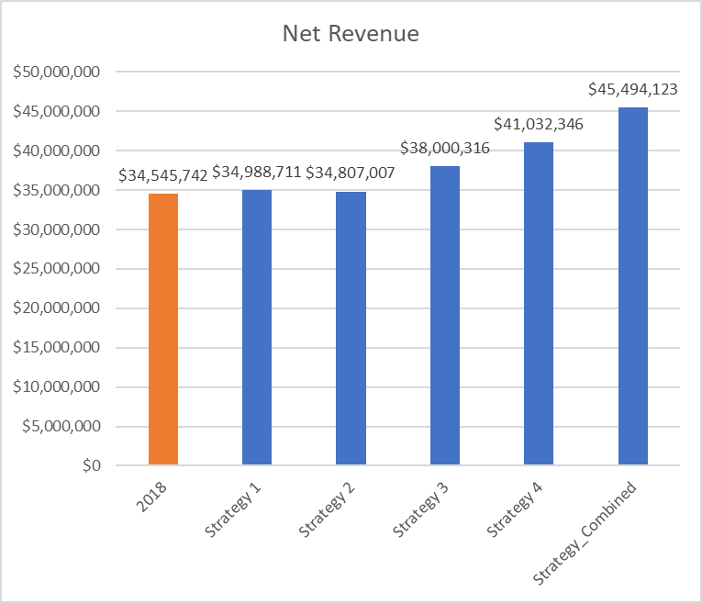
Strategy Forecast
Notes:
-Cutting costs seems to have minimal effect on profits though managing costs is imperative when scaling at volume
-Increasing rental costs seem to be most impactful though it may affect consumer demand. Possibly adjusting pricing structure to frontload costs may better minimize cuts to demand
-Executing on the strategy combined shows dramatic growth on profits with over $11 million earned at a 32% increase.

Slide 6
Recommendations
Execute the combined strategy plan
Monitor performance and results utilizing car dashboard tool provided
Explore adding more luxury cars while not overflooding market

